Slide 1

BIYANS R&D LTD
lıbs for AGRICULTURE
SCIENTIFIC SOLUTIONS FOR ECOLOGICAL PROBLEMS

Slide 2

CONTENT
• Our Vision
• Multidisciplinary Team
• Our strategy
• Services & Solutions
• LIBS Project
• Collaboration Tools
• Current Market
MDMI • 2020

Slide 3

OUR VISION
WE INSPIRED BY NATURE AND SCIENCE
FOR A BETTER FUTURE
SUSTAINABILITY FOR LIFE
ENVIRONMENTAL AND AGRICULTURAL PROTECTION NEEDS GLOBAL SOLUTIONS

Slide 4
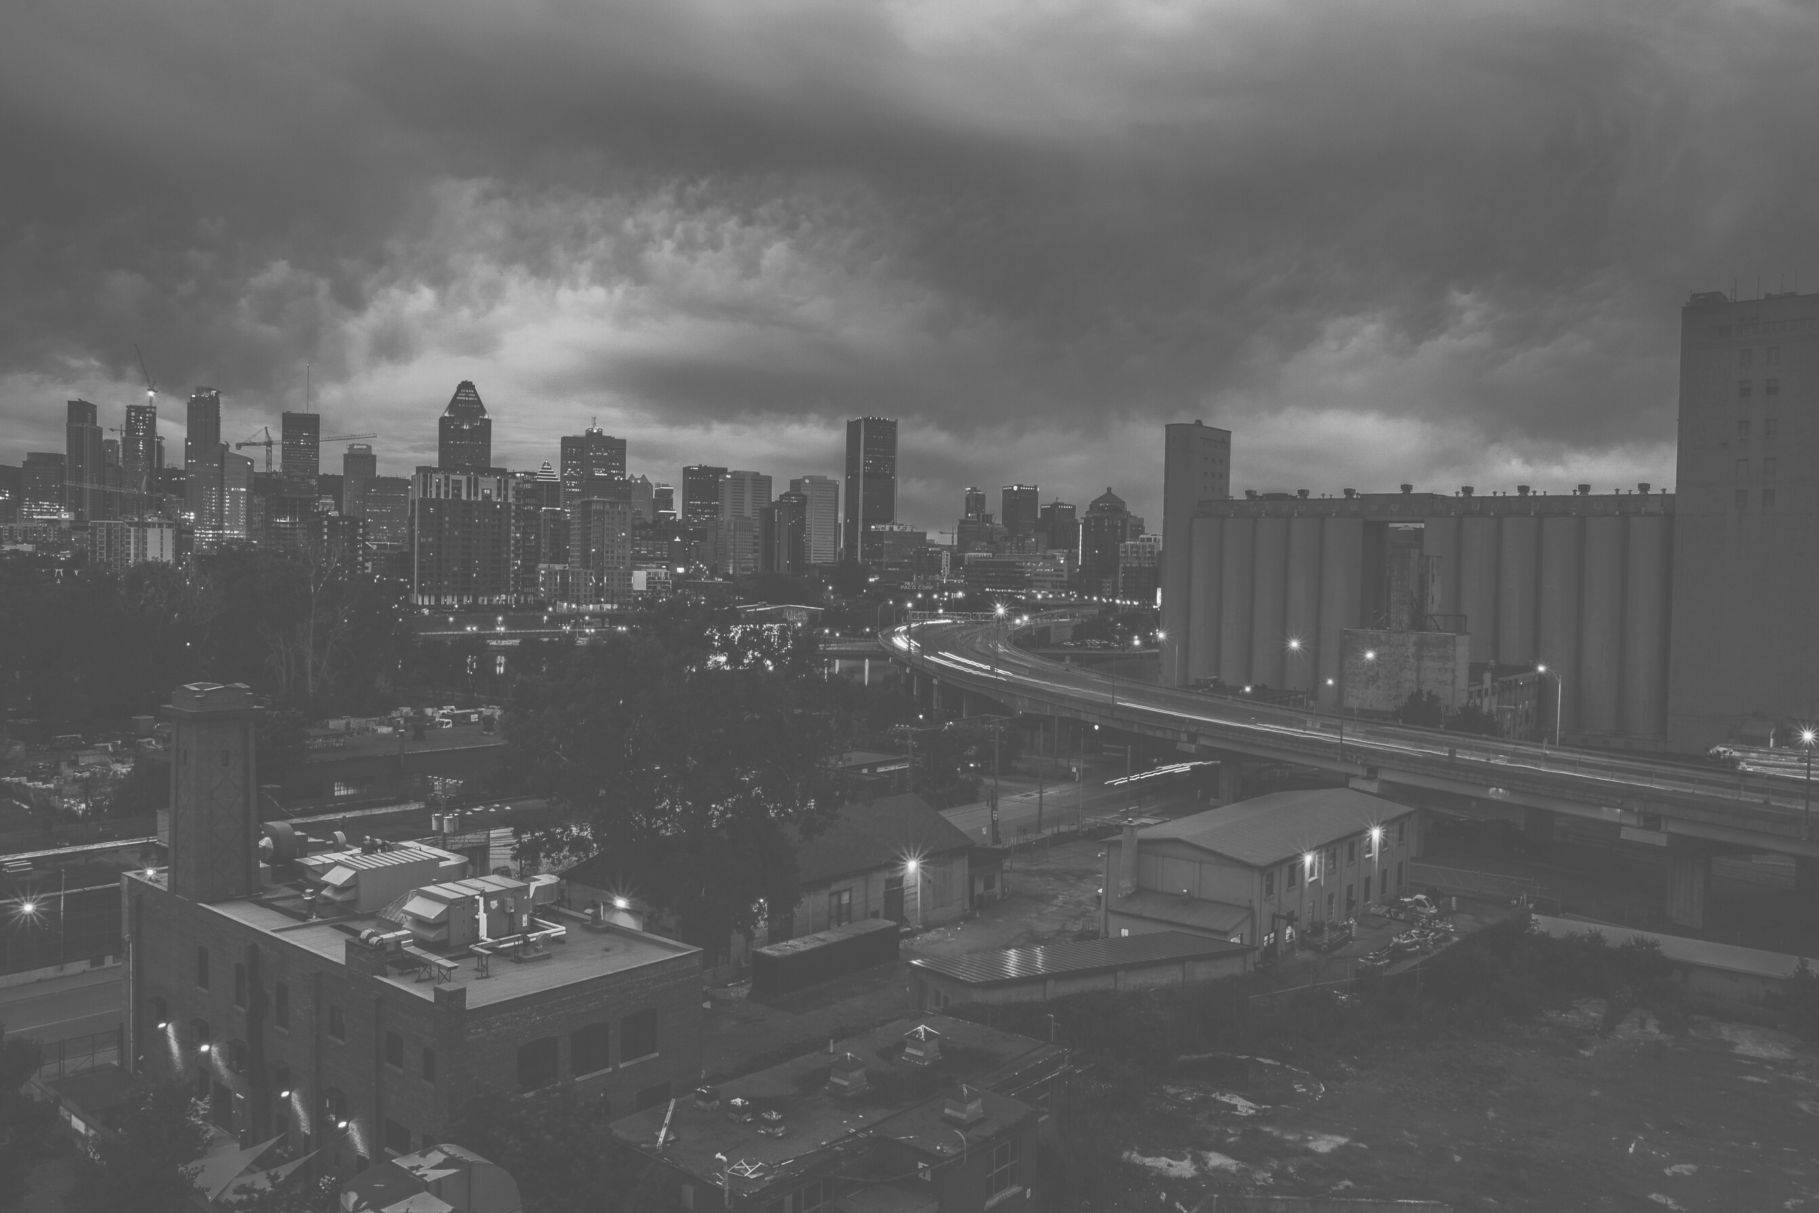
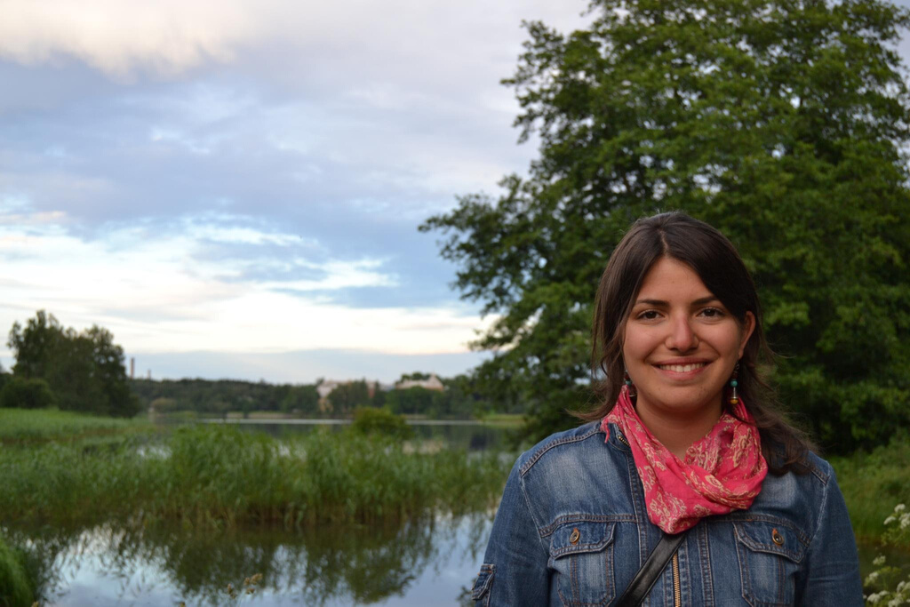
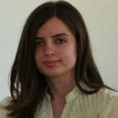


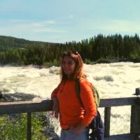
Multidisciplinary Team
ZEYNEP YURTKURAN CETEREZ
SILA TOKSÖZ ATACA
ELIF YURDANUR TAŞEL
Co-Founder, PhD.
Supervisor, Physicist, PhD.
Co-Founder, Manager
Expertise in developing and troubleshooting methods for various biophysical characterization tools
Expertise on Electronic Warfare, Laser Induced Breakdown Spectroscopy, Laser based and Electro-optical Systems
Biologist, Project Coordinator
Expertise on pesticide remediation, pesticide residue detection on environmental samples

Slide 5
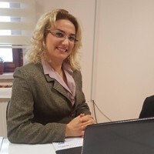


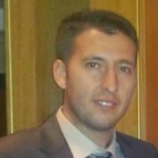
Multidisciplinary Team
ESRA BOZTEPE ÇETİN
UGUR GUDELEK
GÖKHAN ÇETEREZ
Agriculture Engineer
Electric & Electronic Engineer
Material Engineer
Expertise on Soil and Fertilizers, Plant Nutrition Technologies
Expertise on database and software development, qualitative and quantitative analysis and calibration.
Design Engineer, Expertise on Solidworks, Ansys design programs and production process

Slide 6
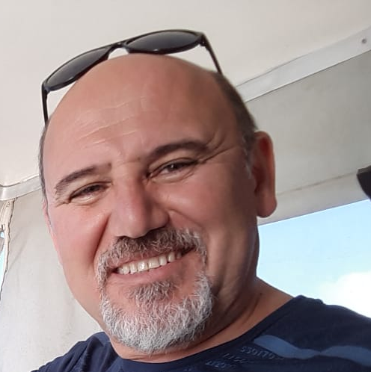
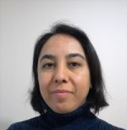
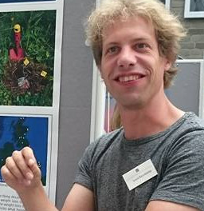
Multidisciplinary Team
YAVUZ TEMEL
GÜL AYYILDIZ
JOOST ALEID KEUSKAMP
Senior Mechanical and Electrical Technician
Plant Biologist, PhD.
Ecologist, Post Doc Researcher
Expertise on technological device development in the R&D and defence field.
Expertise on systematic botany and fermentation systems.
Expert on meta-analysis of carbon sequestration and nutrient cycling in soils

Slide 7
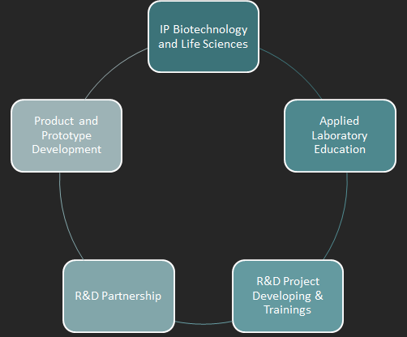
OUR STRATEGY
CUSTOMER PARTNERSHIP RELATED
LIFECYCLE
We believe that our customers are
our future partners...
MDMI • 2020

Slide 8
SERVICES & SOLUTIONS
LABORATORY ANALYSES
SERVICES
SOLUTION BASED PROJECTS
•Microbiology Analysis
•Molecular Biology and Genetic Analysis
•Water Quality Analysis
•Biodiversity Field Analysis
•Lake Protection Analysis
•Soil Field Reporting Services
IPM-4-CITRUS European Union Project
www.ipm-4-citrus.insa-toulouse.fr/
EKOLAKE – Lake Remediation Project with Bentic Barrier Technology
www.ekolake.com

Slide 9
COMPLETED PROJECTS
LIBS –Micropollutant Detection with Laser Induced Breakdown Spectroscopy in Soil (Supported by Turkish Ministry of Agriculture, Environment and Livestock)
EKOLAKE – Lake Remediation Project with Bentic Barrier Technology ( Financed by Turkish Ministry of Forest and Water Affairs IX. Region Department)
Developing Biopesticide Solution Againts for Soil Fungal Agents with Essential Oils ( Supported by Turkey SME Developing R&D Programme)
Bioremediation of Organic Phosphorus Pesticides by Soil Microorganisms (Supported by Technoentrepreneurship Programme)

Slide 10
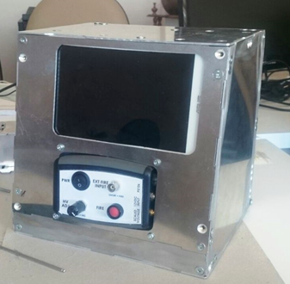
LIBS PROJECT
LASER INDUCED BREAKDOWN SPECTROSCOPY FOR AGRICULTURE,
SOIL ANALYSIS
Determination of Nitrogen, Phosphorous, Potassium and Carbon are our main target elements for detection and manure suggestion system.
*This project is supported by GENERAL DIRECTORATE OF AGRICULTURAL RESEARCH AND POLICIES OF TURKEY

Slide 11
CURRENT MARKET
SOIL ANALYSES IN TURKEY
MARKET SIZE
ADDITIONAL MARKET
30 national research institutes and 300 private soil laboratory routinely realize analysis around Turkey
These laboratories need long sample preparation processes for analyses.
They desire a quick and in situ analysis procedure.
Soil area used for agriculture just in Turkey is 23 million 763 thousand hectors.
The smallest labs are performing 1500 analyses every year.
Ministry of Agriculture anf Foresty in Turkey give finanial supports to farmers for soil analyses.
They can prefer and afford a new portable device.
Every country doing agriculture conduct soil productivity analyses.
They will benefit from compact, portable and realiable devices.
Soil testing sector market valuation in excess of US$ 1,100 Mn by the end of 2017 !

Slide 12
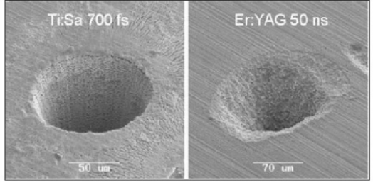
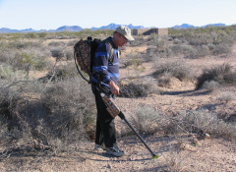
What ıs lıbs?
Laser Induced Breakdown Spectroscopy (LIBS) is used to determine the elemental content of various samples.
Compatible with every physical state
No or little sample preparation
No harm to the sample, a microscopic crater
Real time operation
On site operation
Simultaneous analysis of many elements
Remote sensing possibility

Slide 13
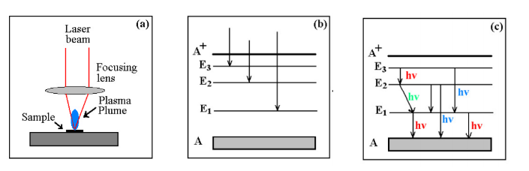
What ıs lıbs?
The LIBS technique inspects the emission spectroscopy of samples of interest for searching certain elements or identifying the unknown composition

Slide 14
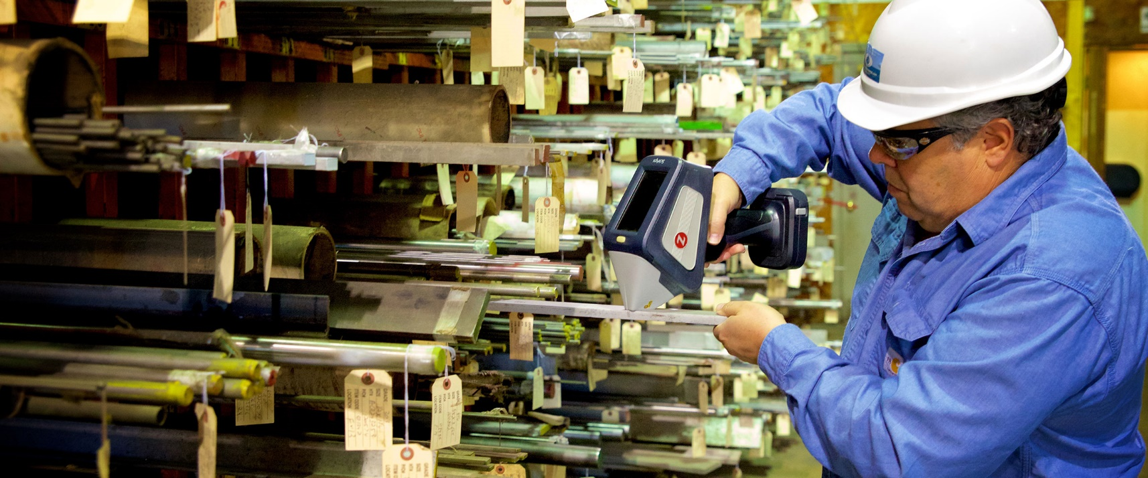
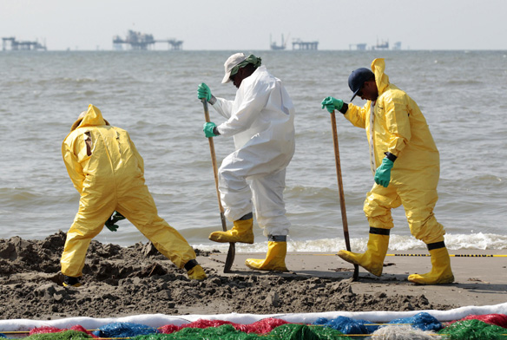
Potentıal applıcatıon fıelds
Chemical and biological threat detection
Health care applications
Explosive detection
Environmental pollution detection
Classifying materials
Recycling
Food Industry

Slide 15
BASICS OF THE SYSTEM
Target
LIBS Equipment
Data
Analysis Tool
Elemental Identification
LASER
Plasma
Emission
Detection

Slide 16
System components
LASER
Nd:YAG, excimer, carbondioxide, Ti:Sapphire, fiber lasers…
Pulse intensity ≥108 W/cm2
Optics
Lens, wavelength seperators, fiber optics…
Detector
PD, PMT, PDA, CCD, CID, ICCD, Czerny-Turner, Echelle spectrometers…
Resolution ≤ 1ns
Wavelength interval min. 200-800 nm
Analysis Tool
Selection criteria
Database

Slide 17
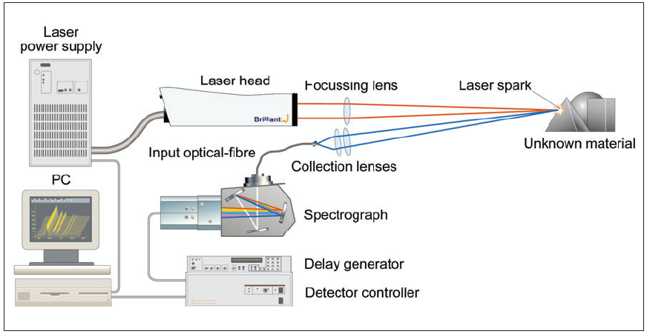
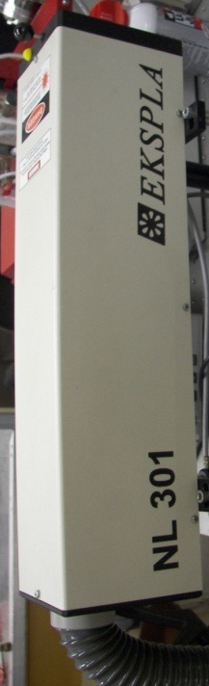
Single Pulsed LIBS
Sample
Plasma
Optic Elements
Spectrometer
Fiber Optic Cable
Relative Intensity (a.u)
LASER
Analysis Computer
410
420
430
440
Wavelength (nm)

Slide 18
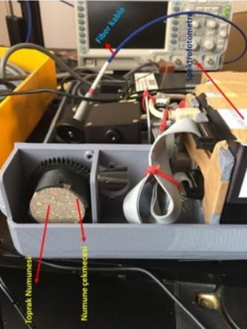
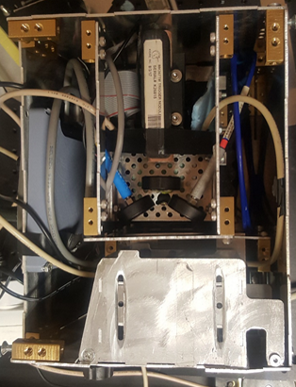
1 ST PROTOTYPE
Portable LIBS for pressed soil samples. 3D plastic prototype for trials of device entegration
2 ND PROTOTYPE
Portable LIBS trials with metal hardware suitable for field conditions.

Slide 19
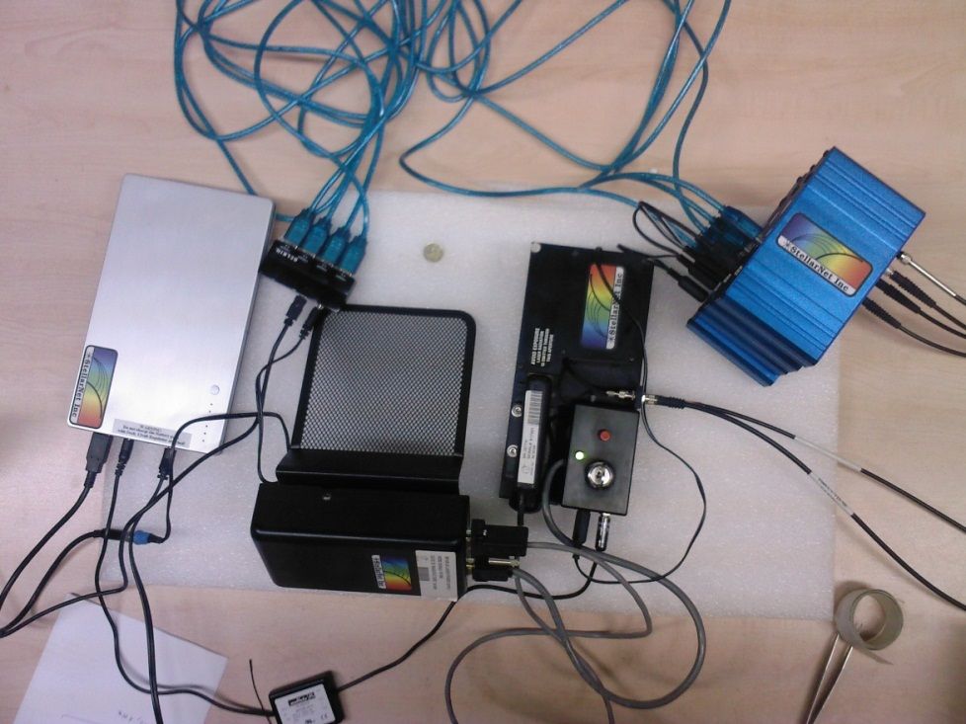
Commercıal lıbs equıpment
Distributed modulity
High resolution
Poor analysis program
Middle East Technical University
Physics Department, LIBS Laboratory

Slide 20
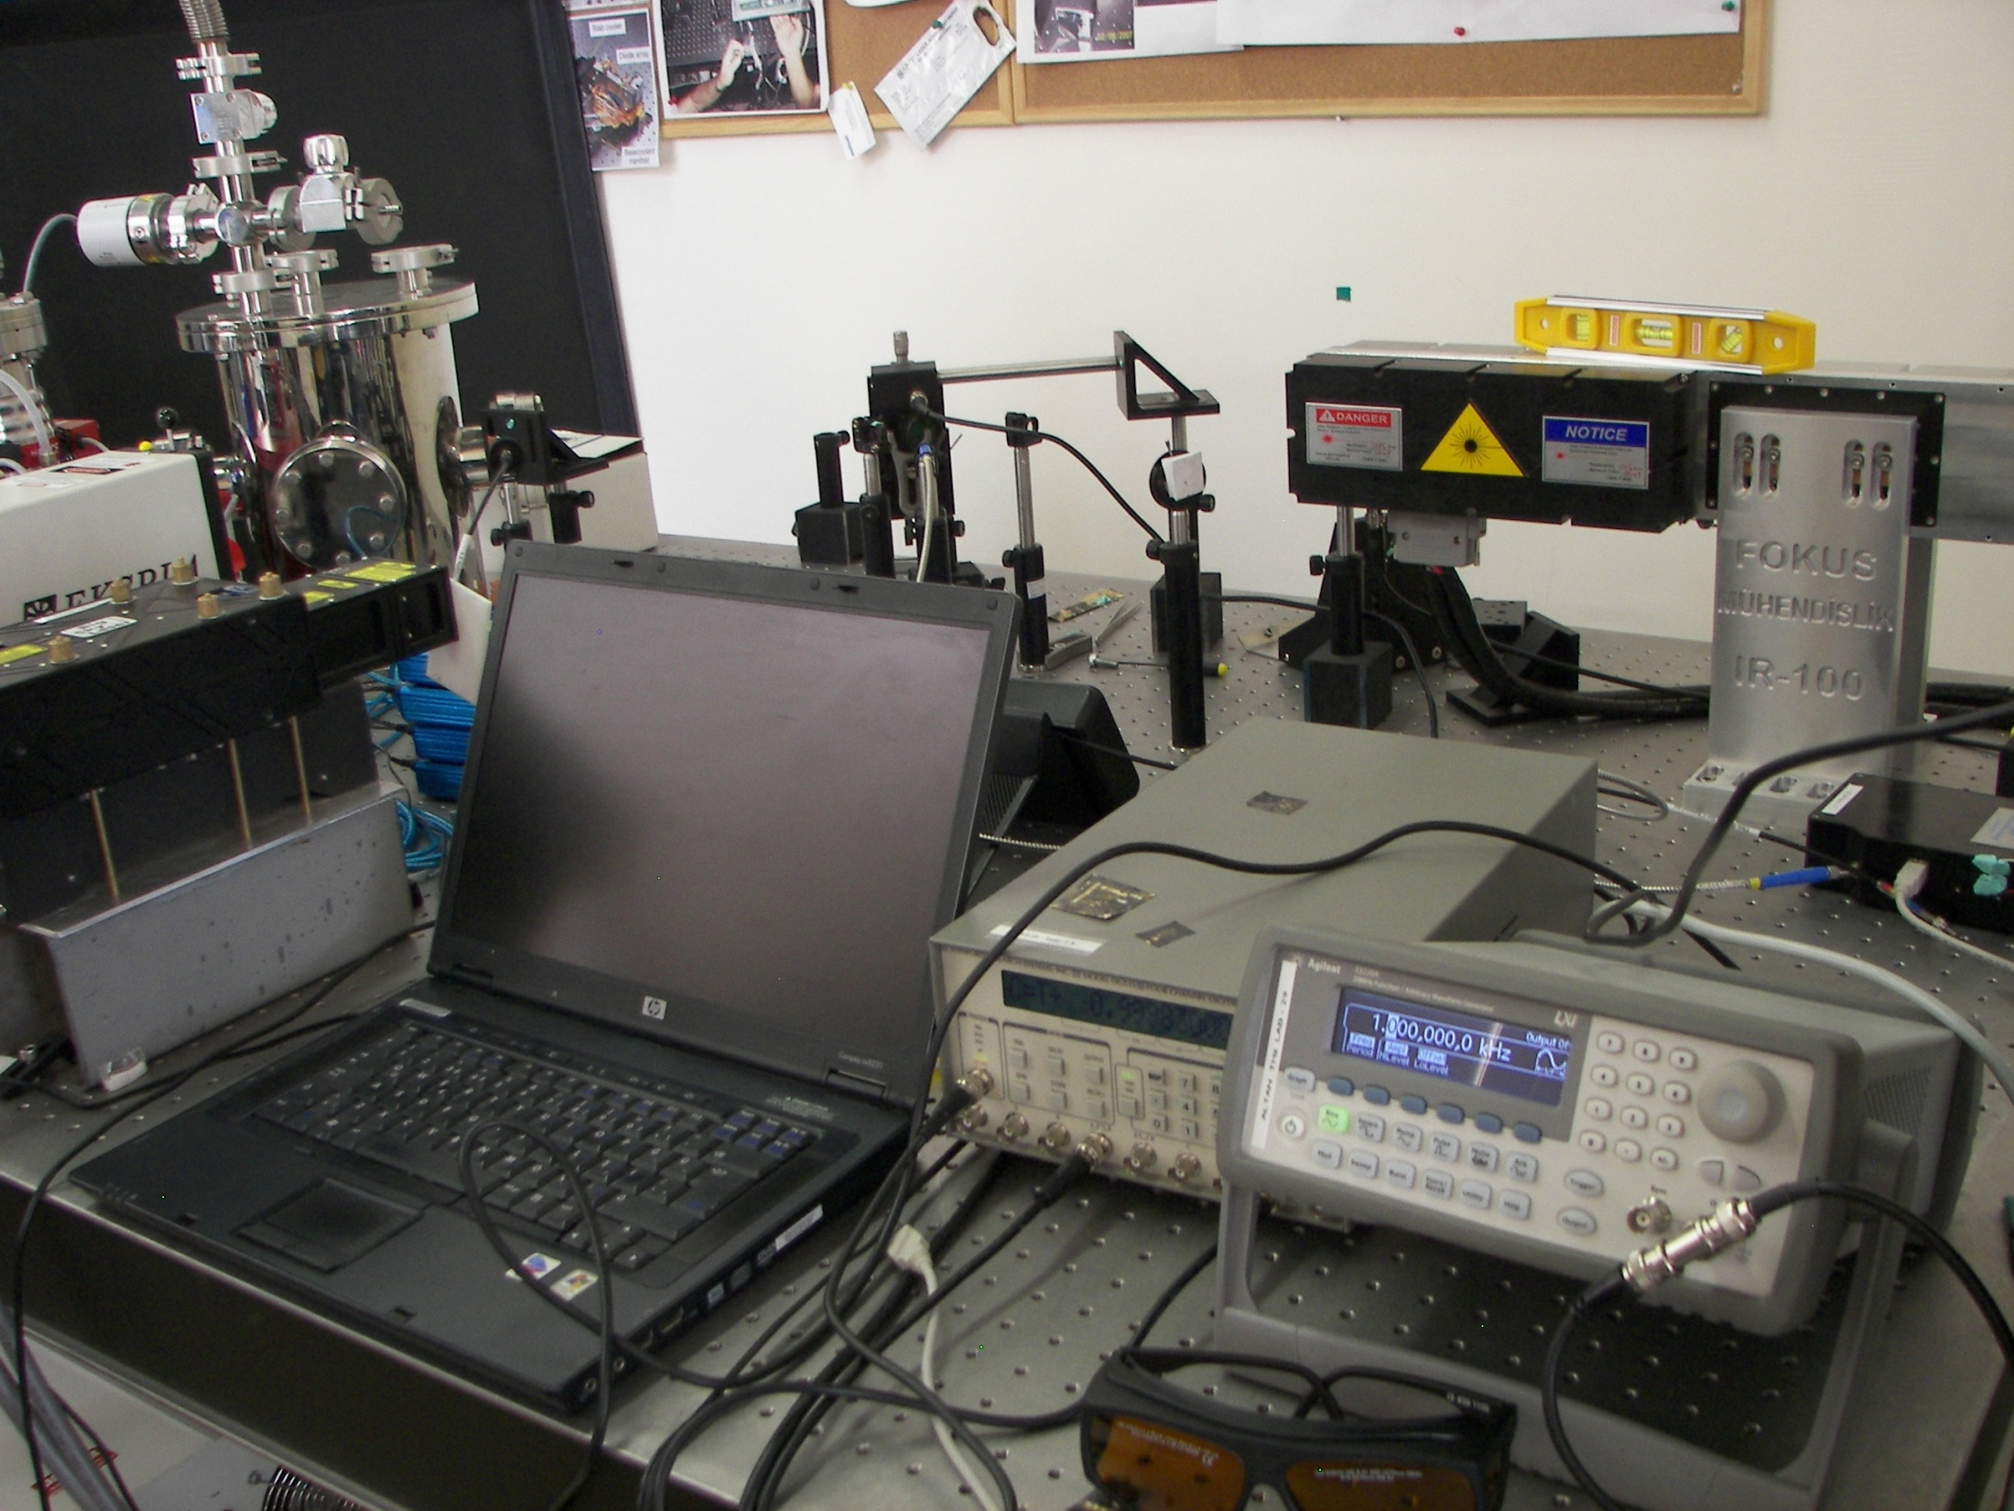
Middle East Technical University
Physics Department, LIBS Laboratory

Slide 21
Double Pulsed LIBS
Sample
LASER 2
Optic Elements
Fiber Optic Cable
Spectrometer
LASER 1
Relative Intensity (a.u)
Analysis Computer
410
420
430
440
Wavelength (nm)

Slide 22
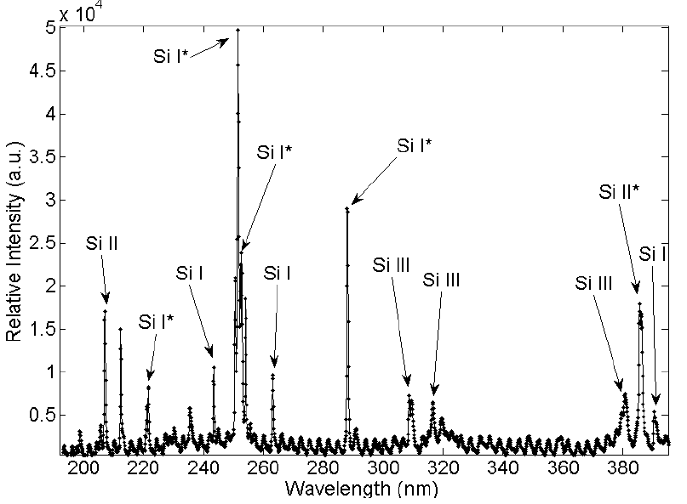
Silicon results

Slide 23
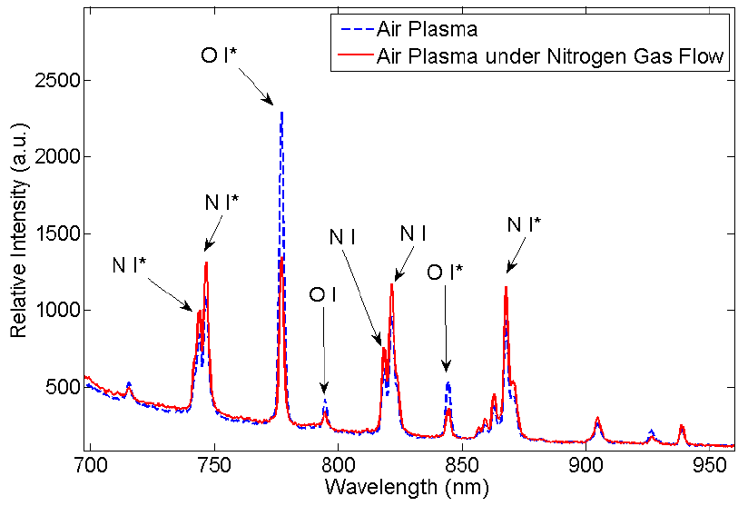
Analysis of LASER focused on N gas flow in air

Slide 24
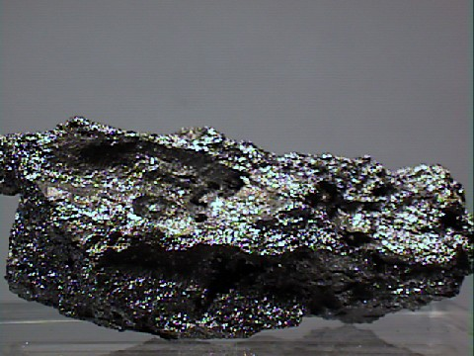
Explosive residue

Slide 25
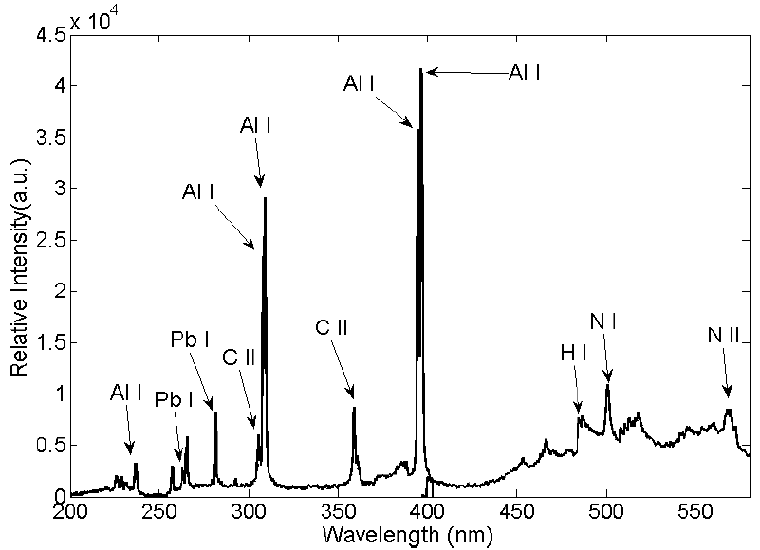
Unknown explosive residue LIBS result

Slide 26
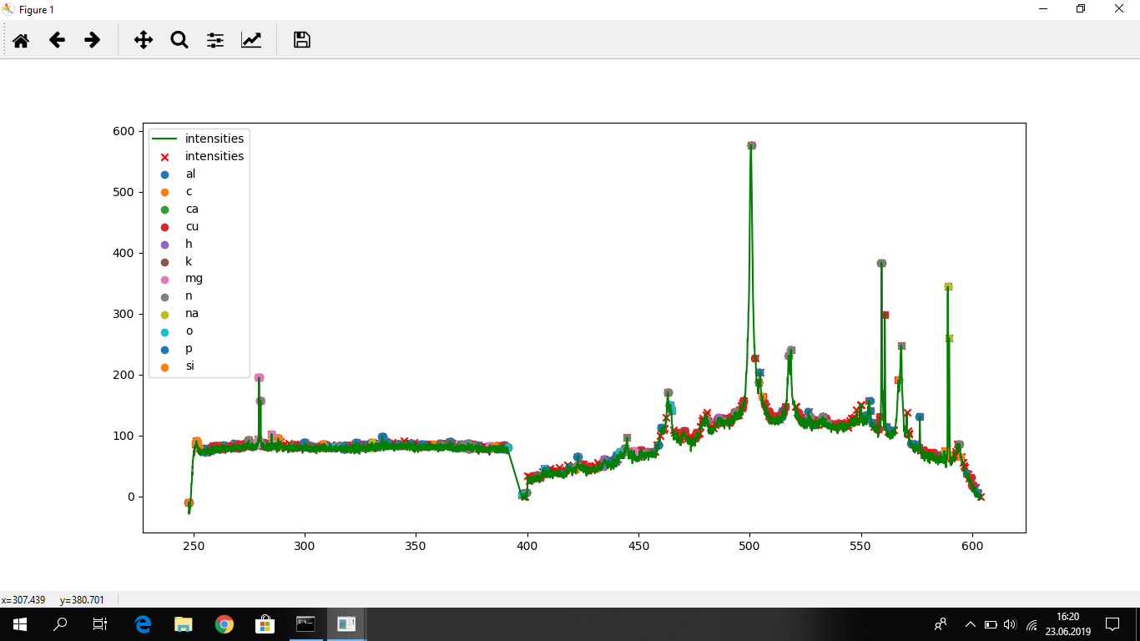

Slide 27
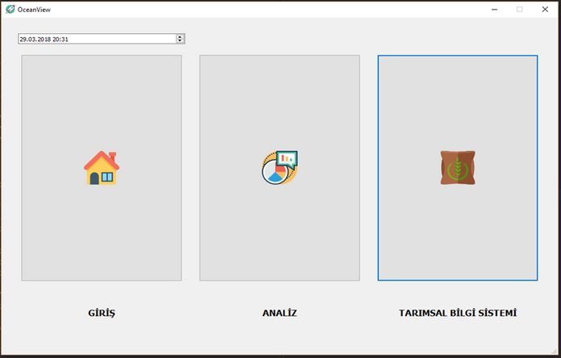
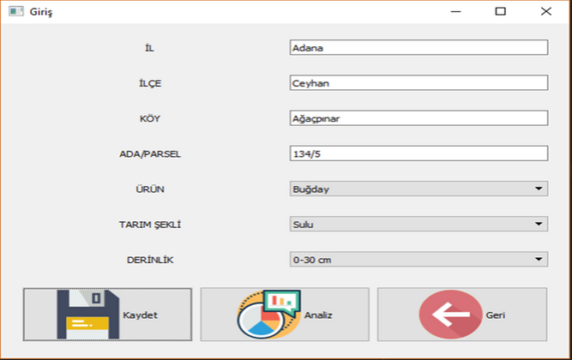
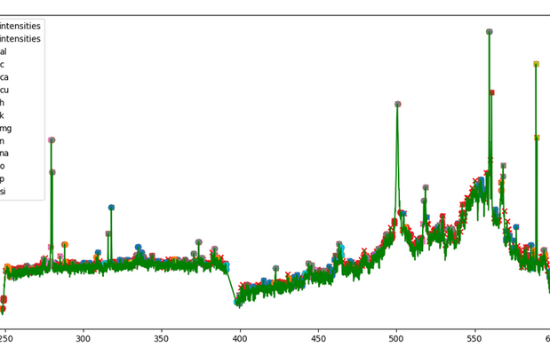
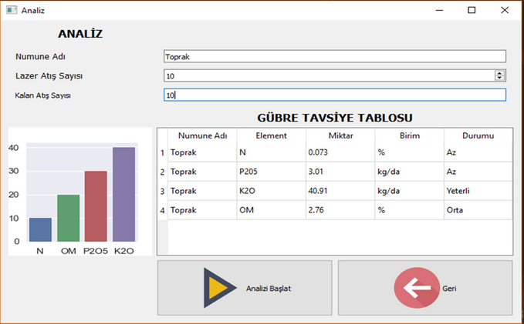
SOFTWARE INTERFACE
Qualitative and quantitative analysis results
User friendly software interface for farmers
Suggestiones for fertilization according to kinds of product and field

Slide 28
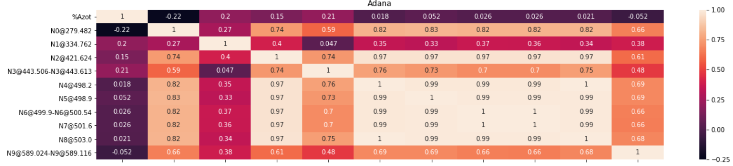
Correlation Matrix - Adana

Slide 29
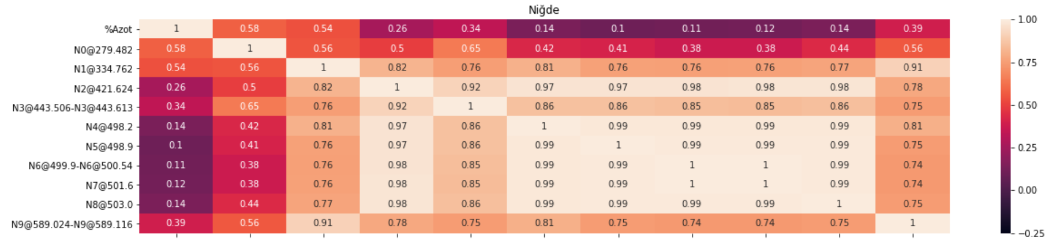
Correlation Matrix - Nigde

Slide 30
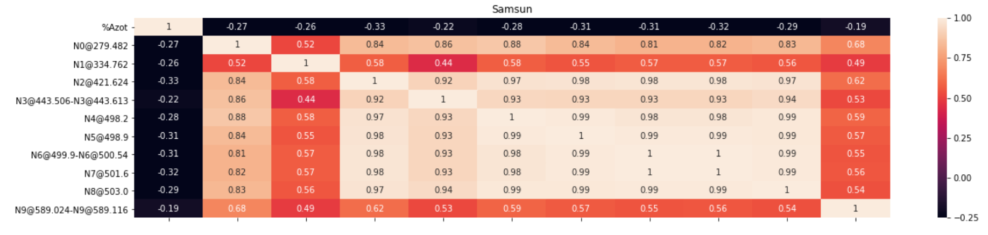
Correlation Matrix - Samsun

Slide 31
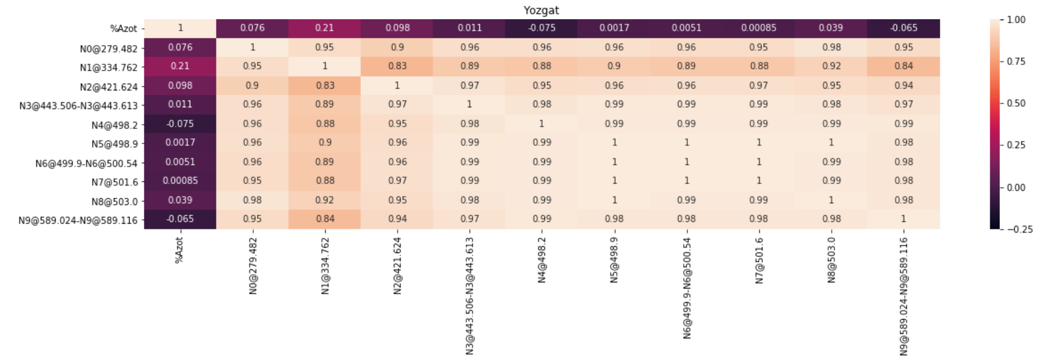
Correlation Matrix - Yozgat

Slide 32
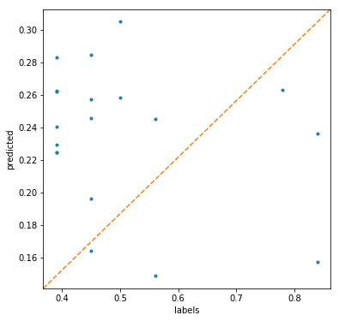
Decision Tree Regressor

Slide 33
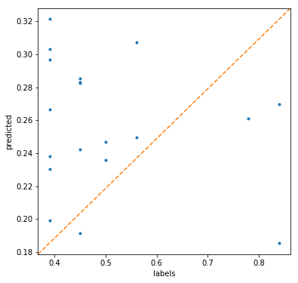
Linear Regression

Slide 34

CONTACT
BEYCANOĞLU İŞ MERKEZI CEYHUN ATIF KANSU CAD. 104, BLOK A2, KAT 5, DAIRE 20, BALGAT, ANKARA, TURKEY
T: +90 312 473 40 05
M: +90 538 524 83 95
ZEYNEP.YURTKURAN@BIYANS.COM
WWW.BIYANS.COM

